Slide 1



Demand and supply side of tobacco tax reforms:
Econometric demand estimations and impact on the
supply chain in Argentina
Ricardo Rozemberg (IDEAS – UNSAM)
Martin González-Rozada (UTDT)
November 10th, 2018
SESSION 5: ACCELERATING PROGRESS ON EFFECTIVE TOBACCO TAX POLICIES IN LATIN AMERICA

Slide 2
I. Demand Side of Tobacco Tax Reforms
First reform: decree 626 of May 2016 that raised the rate of internal taxes from 60 to 75%
Second reform: tax reform law of December 2017 that lowered this rate to 70% but included a minimum tax of 28 pesos per pack of 20 cigarettes adjusted quarterly by inflation. Today this price is 29.87.

Slide 3
Cigarette Tax Structure
Additional Emergency Tax (IAE) was created by law 24,625 sanctioned on December 28, 1995.
Value Added Tax (VAT) is a tax that taxes the consumption of goods and services.
Special Tobacco Fund (FET) was created by law 19,800 in August 1972.
Internal Tax (II). Modified by the reforms

Slide 4
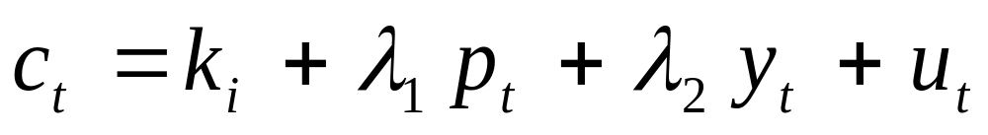
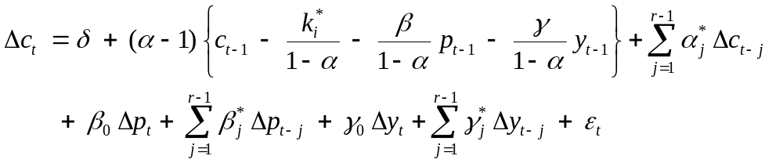
Demand Price Elasticity Estimation
Error Correction Model (ECM) for the consumption of cigarettes. Long run:
Short run:

Slide 5
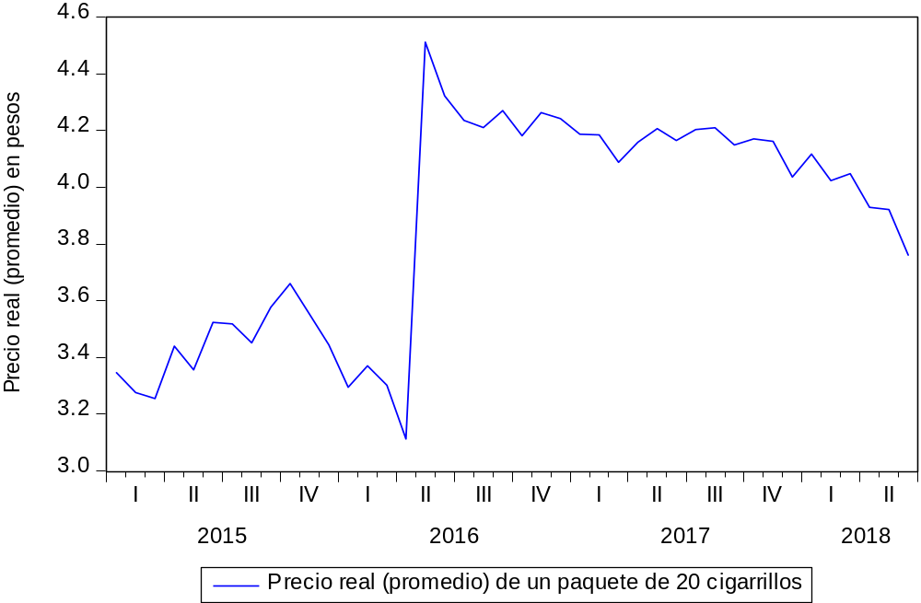
First Tax Reform

Slide 6
Results
LR Demand price elasticity: -0.441
LR Income elasticity: 0.127
SR Demand price elasticity (no reform): -0.911
SR Demand price elasticity with reform: -1.382
Tax burden went from 68.5% to 79.7%
Consumption fell 10% between June and May
Fiscal Revenues increased 29% in the 3rd quarter 2016 and 35% in the 4th quarter 2017 w/r to the 2nd quarter of 2016.

Slide 7
Second Tax Reform
Not fully implemented.
Judicial presentations by the tobacco industry against the implementation of the minimum tax.
Arguing the tax is not constitutional.
Tax burden went from 79.7% to 75.9%

Slide 8
Demand Side of Tobacco Tax Reforms Conclusion
Results of the two tax reforms studied suggest that increasing the rate of ad valorem excise taxes produces more immediate results on cigarette consumption and tax collection than the implementation of a reform that includes an specific tax.

Slide 9
II. Supply Side of Tobacco Tax Reforms
Premise: beyond the need to advance in a more efficient fiscal initiative, it seems to be difficult to control tobacco consumption without a strategy for local supply.
Why we must pay attention to the supply-side?
  Because if tobacco production is not reoriented, supply will continue to create its own demand;
  Because consumption control measures could generate economic and social problems in tobacco producing provinces, which should be considered ex ante, reducing their dependency on tobacco´ activity;
  Due to the Argentinean tax and federal organization structure, any change in the tax burden over tobacco needs the support of the representatives of producing provinces in the National Congress.

Slide 10
In Argentina exist a regime for demand control, which also incentives tobacco supply…
Tobacco Special Fund (FET) was created in 1972 to promote the activity in the northern region of the country; it is financed by 7% of the cigarettes price. It also holds 0,35% for union controlled health insurance agencies (“obras sociales”) and 1% for commercialization costs.
Distribution: 80% as an overprice for producers, 20% for investment plans within the sector (including reconversion). Producer income: collection price + «FET price».
Accession to WTO (1994): limits the overprice to $ 75 M annually. The rest of the 80% is transferred through plans.
The main actors in FET distribution are Provincial Executing Agencies (“UEPs”), which represent large producers in each province.

Slide 11
…the existence of FET block any reconversion initiative
Avoids that market incentives (prices) work for farmers;
Only tobacco farmers can receive the benefits;
Is managed by stakeholders interested in statu-quo;
Gives the tobacco sector a cohesion and a dynamics which does not exist in any other alternative crop;
Fails in taking advantage of the funds available for reconversion plans due to limited technical capacities

Slide 12
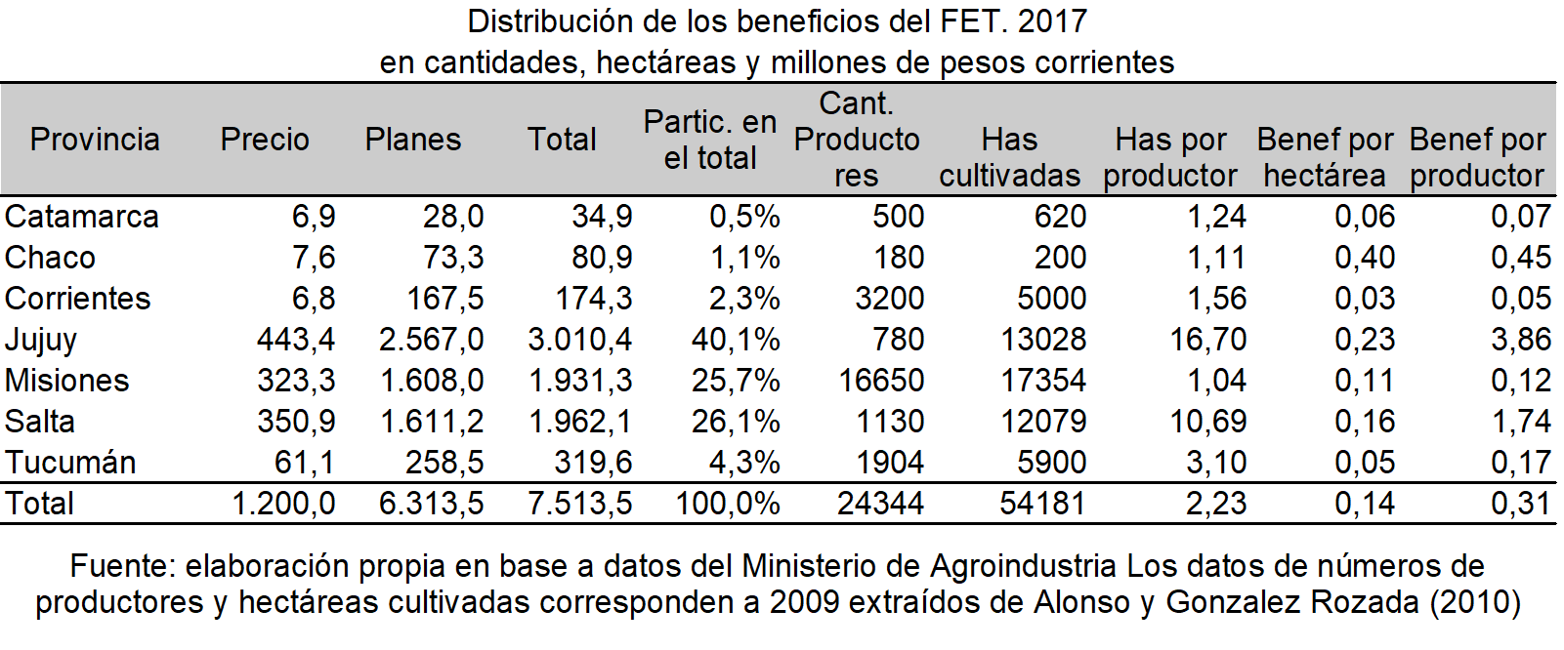
…and FET benefits large producers

Slide 13
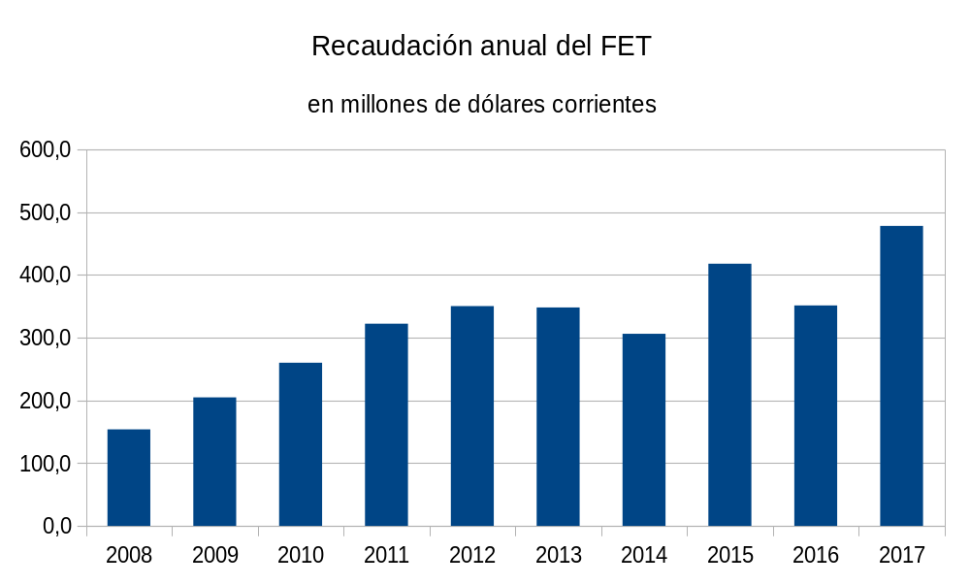
… FET resources are relevant and strengthen the economic policy challenges
Source: own elaboration based on Ministry of Agriculture.

Slide 14
…reconversion is technically possible but difficult because of the value chain configuration and the role of tobacco companies
International and national experience shows that crop reconversion is possible, but it faces several difficulties:
  The existence of an integrated tobacco production system (contract farming, logistic and distribution, etc.)
  Tobacco and alternatives crops: “the profitability issue”.
  Economic policy problems carried out through public support to the tobacco sector.
In Argentina, these challenges are more complex because of the FET.

Slide 15
Supply Side of Tobacco Tax Reforms Conclusions
In Argentina, tobacco related public policies merges measures to promote supply, with demand control mechanisms;
Beyond the advantages of the tobacco value chain, the main characteristic of this production is the “FET” benefits, which give tobacco a spurious competitiveness;
The “FET” generate a powerful coalition that blocks any change in statu quo. While tobacco exports reached an average of $ 317 millions in the last decade, FET has collected an average of $ 380 in the same period;
Far from generating crop diversification, the “FET” has been used to expand and consolidate tobacco production.

Slide 16
Supply Side of Tobacco Tax Reforms. Conclusions
“FET” coalition impose a huge restriction for crop reconversion. However, some actions could moderate the “FET” impact:
  Improve the use of the 20% fund, which mainly benefits small farmers;
  Prioritize diversification projects;
  Allow farmers to receive “FET” benefits for a period of 3 to 5 years even tough they no longer produce tobacco;
And some more ambitious actions for the long-term:
  Implement integral regional development programs which include reconversion of tobacco areas;
  Develop an awareness campaign towards producers on the falling trend in tobacco consumption worldwide;
  Introduce an export tax for tobacco, to compensate the benefits received by traders through “FET”.

Slide 17
Demand and supply side of tobacco tax reforms:
Econometric demand estimations and impact on the
supply chain in Argentina
Ricardo Rozemberg (IDEAS – UNSAM)
Martin González-Rozada (UTDT)
November 10th, 2018
SESSION 5: ACCELERATING PROGRESS ON EFFECTIVE TOBACCO TAX POLICIES IN LATIN AMERICA

